Slide 1
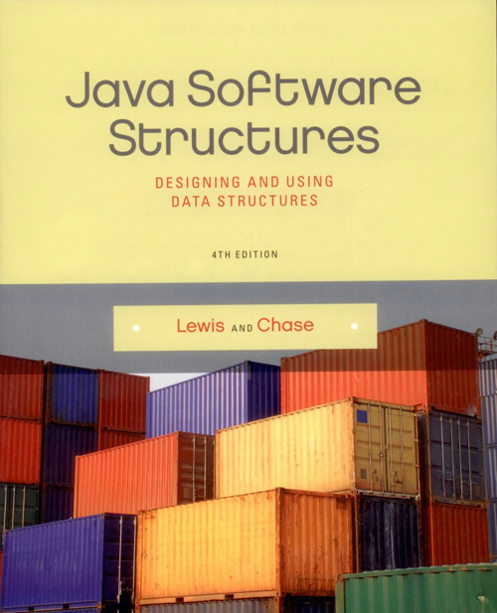
Chapter 5
Queues

Slide 2
Chapter Scope
Queue processing
Using queues to solve problems
Various queue implementations
Comparing queue implementations

Slide 3
Queues
A queue is a collection whose elements are added on one end and removed from the other
Therefore a queue is managed in a FIFO fashion: first in, first out
Elements are removed in the same order they arrive
Any waiting line is a queue:
the check out line at a grocery store
the cars at a stop light
an assembly line

Slide 4
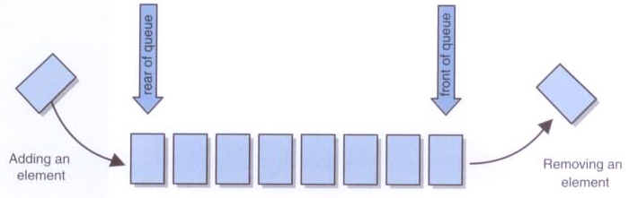
Queues
A queue, conceptually:

Slide 5
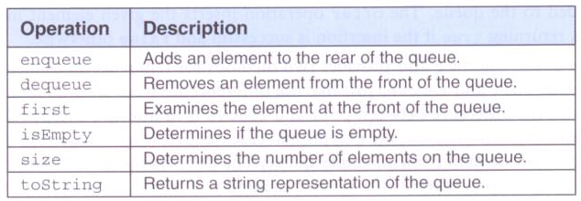
Queues
Standard queue operations:

Slide 6
Queues in the Java API
The Java Collections API is not consistent about its implementation of collections
For queues, the API provides a Queue interface, then various classes such as LinkedList implement the interface
Furthermore, the Queue interface defines two versions of the methods that add and remove elements from the queue
The difference in the two versions is how exceptional situations are handled

Slide 7
Queues in the Java API
The add method throws an exception if the element cannot be added, and the offer method returns a boolean indicating success or failure
When the queue is empty, the remove method throws an exception and the poll method returns null
The goal is to give the user the option of handling exceptional cases in whatever way is preferred

Slide 8
Coded Messages
Let's use a queue to help us encode and decode messages
A Ceasar cipher encodes a message by shifting each letter in a message by a constant amount k
If k is 5, A becomes F, B becomes G, etc.
However, this is fairly easy to break
An improvement can be made by changing how much a letter is shifted depending on where the letter is in the message

Slide 9
Coded Messages
A repeating key is a series of integers that determine how much each character is shifted
For example, consider the repeating key
3 1 7 4 2 5
The first character in the message is shifted 3, the next 1, the next 7, and so on
When the key is exhausted, we just start over at the beginning of the key

Slide 10
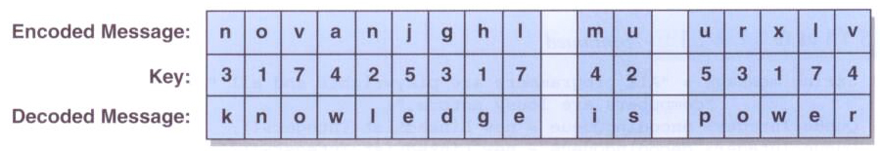
Coded Messages
Decoding a message using a repeating key:

Slide 11
/**
* Codes demonstrates the use of queues to encrypt and decrypt messages.
*
* @author Lewis and Chase
* @version 4.0
*/
public class Codes
{
/**
* Encode and decode a message using a key of values stored in
* a queue.
*/
public static void main(String[] args)
{
int[] key = {5, 12, -3, 8, -9, 4, 10};
Integer keyValue;
String encoded = "", decoded = "";
String message = "All programmers are playwrights and all " +
"computers are lousy actors.";
Queue<Integer> encodingQueue = new LinkedList<Integer>();
Queue<Integer> decodingQueue = new LinkedList<Integer>();
// load key queues
for (int scan = 0; scan < key.length; scan++)
{
encodingQueue.add(key[scan]);
decodingQueue.add(key[scan]);
}

Slide 12
// encode message
for (int scan = 0; scan < message.length(); scan++)
{
keyValue = encodingQueue.remove();
encoded += (char) (message.charAt(scan) + keyValue);
encodingQueue.add(keyValue);
}
System.out.println ("Encoded Message:\n" + encoded + "\n");
// decode message
for (int scan = 0; scan < encoded.length(); scan++)
{
keyValue = decodingQueue.remove();
decoded += (char) (encoded.charAt(scan) - keyValue);
decodingQueue.add(keyValue);
}
System.out.println ("Decoded Message:\n" + decoded);
}
}

Slide 13
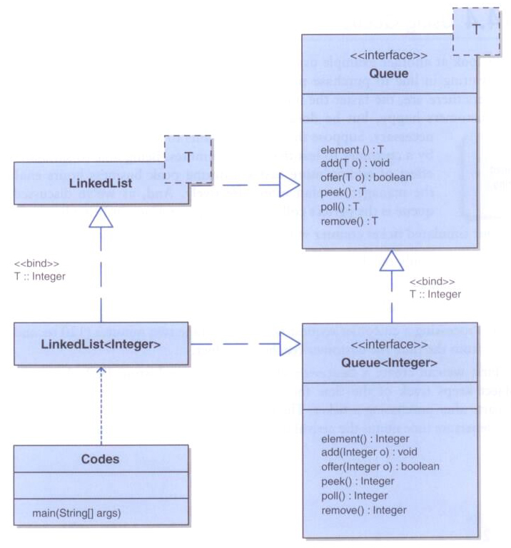
Coded Messages

Slide 14
Ticket Counter Simulation
Now let's use a queue to simulate the waiting line at a movie theatre
The goal is to determine how many cashiers are needed to keep the wait time below 7 minutes
We'll assume:
customers arrive on average every 15 seconds
processing a request takes two minutes once a customer reaches a cashier

Slide 15
/**
* Customer represents a waiting customer.
*
* @author Lewis and Chase
* @version 4.0
*/
public class Customer
{
private int arrivalTime, departureTime;
/**
* Creates a new customer with the specified arrival time.
* @param arrives the arrival time
*/
public Customer(int arrives)
{
arrivalTime = arrives;
departureTime = 0;
}
/**
* Returns the arrival time of this customer.
* @return the arrival time
*/
public int getArrivalTime()
{
return arrivalTime;
}

Slide 16
/**
* Sets the departure time for this customer.
* @param departs the departure time
**/
public void setDepartureTime(int departs)
{
departureTime = departs;
}
/**
* Returns the departure time of this customer.
* @return the departure time
*/
public int getDepartureTime()
{
return departureTime;
}
/**
* Computes and returns the total time spent by this customer.
* @return the total customer time
*/
public int totalTime()
{
return departureTime - arrivalTime;
}
}

Slide 17
import java.util.*;
/**
* TicketCounter demonstrates the use of a queue for simulating a line of customers.
*
* @author Lewis and Chase
* @version 4.0
*/
public class TicketCounter
{
private final static int PROCESS = 120;
private final static int MAX_CASHIERS = 10;
private final static int NUM_CUSTOMERS = 100;
public static void main(String[] args)
{
Customer customer;
Queue<Customer> customerQueue = new LinkedList<Customer>();
int[] cashierTime = new int[MAX_CASHIERS];
int totalTime, averageTime, departs, start;
// run the simulation for various number of cashiers
for (int cashiers = 0; cashiers < MAX_CASHIERS; cashiers++)
{
// set each cashiers time to zero initially
for (int count = 0; count < cashiers; count++)
cashierTime[count] = 0;
// load customer queue
for (int count = 1; count <= NUM_CUSTOMERS; count++)
customerQueue.add(new Customer(count * 15));

Slide 18
totalTime = 0;
// process all customers in the queue
while (!(customerQueue.isEmpty()))
{
for (int count = 0; count <= cashiers; count++)
{
if (!(customerQueue.isEmpty()))
{
customer = customerQueue.remove();
if (customer.getArrivalTime() > cashierTime[count])
start = customer.getArrivalTime();
else
start = cashierTime[count];
departs = start + PROCESS;
customer.setDepartureTime(departs);
cashierTime[count] = departs;
totalTime += customer.totalTime();
}
}
}
// output results for this simulation
averageTime = totalTime / NUM_CUSTOMERS;
System.out.println("Number of cashiers: " + (cashiers + 1));
System.out.println("Average time: " + averageTime + "\n");
}
}
}

Slide 19
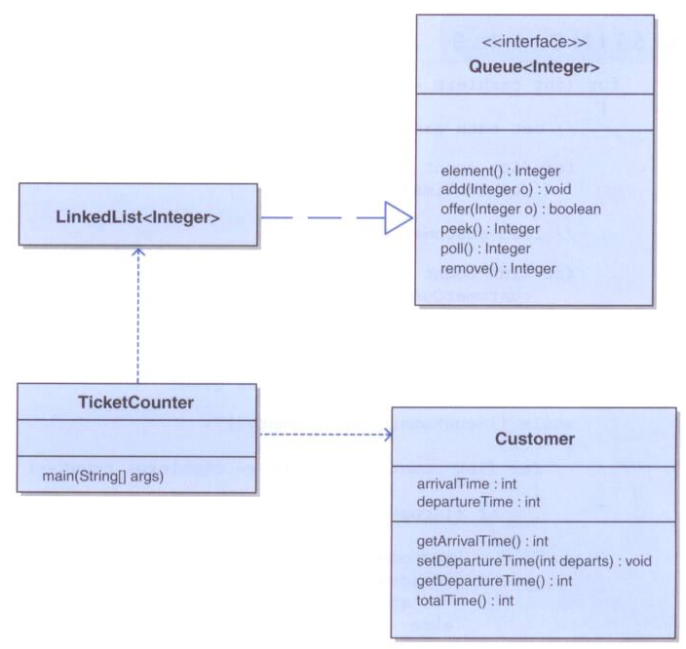
Ticket Counter Simulation

Slide 20
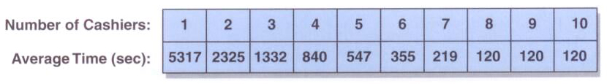
Ticket Counter Simulation
The results of the simulation:
With the goal of an average time of less than seven minutes (420 secs), six cashiers will suffice
Adding more than eight cashiers will not improve the situation

Slide 21
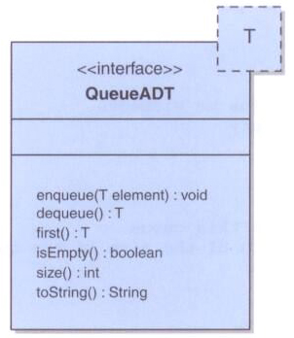
A Queue ADT
Defining our own interface for a queue, using only the classic operations:

Slide 22
package jsjf;
/**
* QueueADT defines the interface to a queue collection.
*
* @author Lewis and Chase
* @version 4.0
*/
public interface QueueADT<T>
{
/**
* Adds one element to the rear of this queue.
* @param element the element to be added to the rear of the queue
*/
public void enqueue(T element);
/**
* Removes and returns the element at the front of this queue.
* @return the element at the front of the queue
*/
public T dequeue();
/**
* Returns without removing the element at the front of this queue.
* @return the first element in the queue
*/
public T first();

Slide 23
/**
* Returns true if this queue contains no elements.
* @return true if this queue is empty
*/
public boolean isEmpty();
/**
* Returns the number of elements in this queue.
* @return the integer representation of the size of the queue
*/
public int size();
/**
* Returns a string representation of this queue.
* @return the string representation of the queue
*/
public String toString();
}

Slide 24
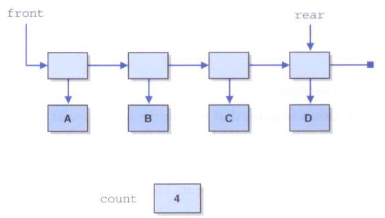
Implementing a Queue with Links
Since operations work on both ends of the queue, we'll use both front and rear references

Slide 25
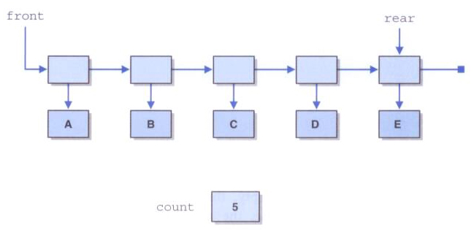
Implementing a Queue with Links
After adding element E to the rear of the queue:

Slide 26
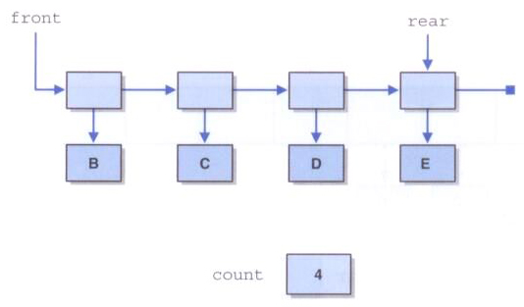
Implementing a Queue with Links
After removing an element from the front:

Slide 27
package jsjf;
import jsjf.exceptions.*;
/**
* LinkedQueue represents a linked implementation of a queue.
*
* @author Lewis and Chase
* @version 4.0
*/
public class LinkedQueue<T> implements QueueADT<T>
{
private int count;
private LinearNode<T> head, tail;
/**
* Creates an empty queue.
*/
public LinkedQueue()
{
count = 0;
head = tail = null;
}

Slide 28
/**
* Adds the specified element to the tail of this queue.
* @param element the element to be added to the tail of the queue
*/
public void enqueue(T element)
{
LinearNode<T> node = new LinearNode<T>(element);
if (isEmpty())
head = node;
else
tail.setNext(node);
tail = node;
count++;
}

Slide 29
/**
* Removes the element at the head of this queue and returns a
* reference to it.
* @return the element at the head of this queue
* @throws EmptyCollectionException if the queue is empty
*/
public T dequeue() throws EmptyCollectionException
{
if (isEmpty())
throw new EmptyCollectionException("queue");
T result = head.getElement();
head = head.getNext();
count--;
if (isEmpty())
tail = null;
return result;
}

Slide 30
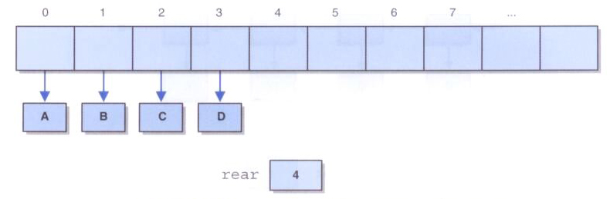
Implementing a Queue with an Array
If we implement a queue as we did a stack, one end would be fixed at index 0:
The problem is that (unlike a stack) a queue operates at both ends
To be efficient, we must avoid shifting elements

Slide 31
Implementing a Queue with an Array
A better solution is to treat the array as circular
A circular array is a a regular array that is treated as if it loops back around on itself
That is, the last index is thought to precede index 0
We use two integers to keep track of where the front and rear of the queue are at any given time

Slide 32
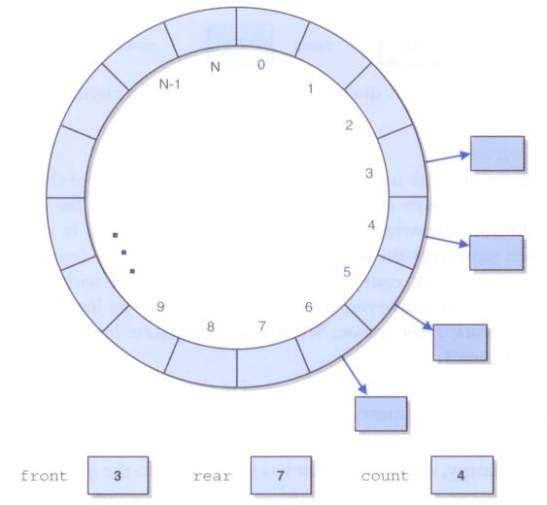
Implementing a Queue with an Array
A queue implemented using a circular queue:

Slide 33
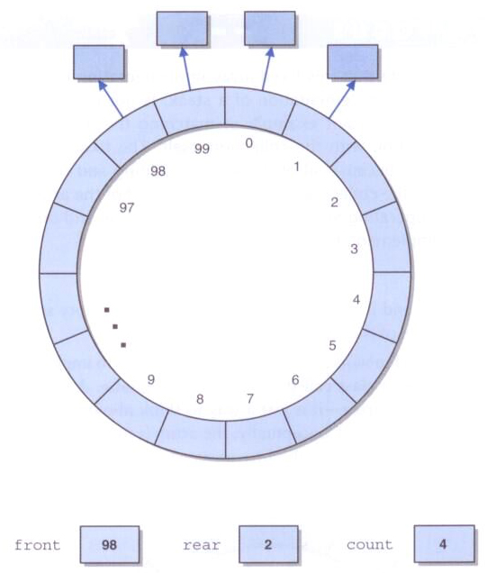
Implementing a Queue with an Array
At some point, the elements of the queue may straddle the end of the array:

Slide 34
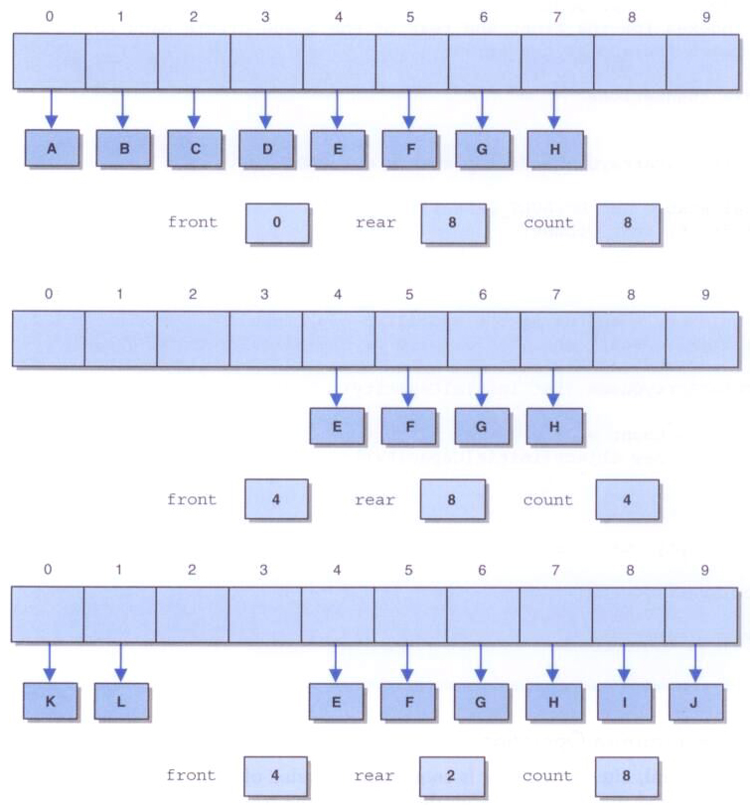
After A-H have been enqueued:
After A-D have been dequeueed:
After I, J, K, and L have been enqueued:

Slide 35
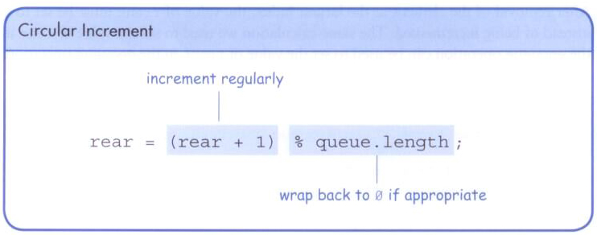
Implementing a Queue with an Array
Both the front and rear index values are incremented, wrapping back to 0 when necessary

Slide 36
package jsjf;
import jsjf.exceptions.*;
/**
* CircularArrayQueue represents an array implementation of a queue in
* which the indexes for the front and rear of the queue circle back to 0
* when they reach the end of the array.
*
* @author Lewis and Chase
* @version 4.0
*/
public class CircularArrayQueue<T> implements QueueADT<T>
{
private final static int DEFAULT_CAPACITY = 100;
private int front, rear, count;
private T[] queue;

Slide 37
/**
* Creates an empty queue using the specified capacity.
* @param initialCapacity the initial size of the circular array queue
*/
public CircularArrayQueue (int initialCapacity)
{
front = rear = count = 0;
queue = (T[]) (new Object[initialCapacity]);
}
/**
* Creates an empty queue using the default capacity.
*/
public CircularArrayQueue()
{
this(DEFAULT_CAPACITY);
}

Slide 38
/**
* Adds the specified element to the rear of this queue, expanding
* the capacity of the queue array if necessary.
* @param element the element to add to the rear of the queue
*/
public void enqueue(T element)
{
if (size() == queue.length)
expandCapacity();
queue[rear] = element;
rear = (rear+1) % queue.length;
count++;
}

Slide 39
/**
* Creates a new array to store the contents of this queue with
* twice the capacity of the old one.
*/
private void expandCapacity()
{
T[] larger = (T[]) (new Object[queue.length *2]);
for (int scan = 0; scan < count; scan++)
{
larger[scan] = queue[front];
front = (front + 1) % queue.length;
}
front = 0;
rear = count;
queue = larger;
}

Slide 40
/**
* Removes the element at the front of this queue and returns a
* reference to it.
* @return the element removed from the front of the queue
* @throws EmptyCollectionException if the queue is empty
*/
public T dequeue() throws EmptyCollectionException
{
if (isEmpty())
throw new EmptyCollectionException("queue");
T result = queue[front];
queue[front] = null;
front = (front+1) % queue.length;
count--;
return result;
}

